Slide 1
MINI PROJECT
PRESENTATION
Presented by:
Sanjay T
Samuel Tennyson T
Pradesh GV
Prasath K

Slide 2
AUTOMATIC EXAM TIME TABLE SCHEDULER

Slide 3
ABSTRACT

Slide 4
Exam time table scheduling problem
Every education system faces this problem.
Due to vast number of courses in universities.
Graph colouring approach is used to solve this problem.

Slide 5
PROBLEM
STAEMENT

Slide 6
We are given the following subjects to schedule.
Semester 1:
Engineering mathematics 1(MA5158)
Python(GE5153)
Engineering physics(PH5151)
Semester 3:
Engineering mathematics 1(MA5158)
Discrete Mathematics(MA5302)
Software Engineering(IT5302)

Slide 7
Semester 5:
Compiler Engineering(IT5502)
Computer Networks(IT5551)
Semester 3&5:
Philosophy(HU5176)
Values and Ethics(HU5172)

Slide 8
SOLUTION

Slide 9
For solving this problem, we make vertices of total number of subject, and assign every vertex to one subject. Then we make edge between all subject of every semester.

Slide 10
PH5151
MA5158
GE5153
HU5176
MA5302
IT5551
HU5172
IT5302
IT5502

Slide 11
MA5302 | IT5302 | HU5176 | HU5172 | IT5502 | IT551 | MA5158 | PH5151 | GE5153
3 | 3 | 3&5 | 3&5 | 5 | 5 | 1&3 | 1 | 1
1 | 2 | 3 | 4 | 1 | 2 | 5 | 1 | 2

Slide 12
PH5151
MA5158
GE5153
HU5176
MA5302
IT5551
HU5172
IT5302
IT5502

Slide 13
SCREENSHOTS

Slide 14
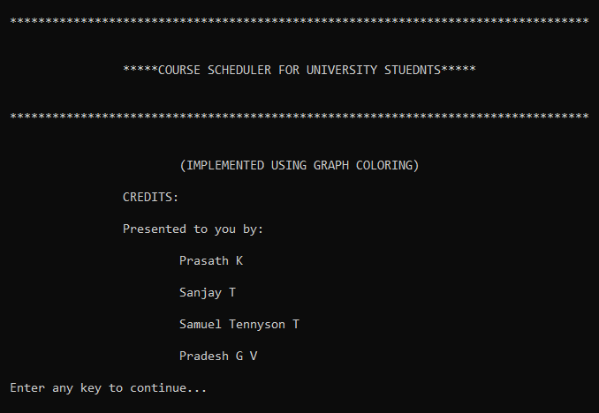

Slide 15
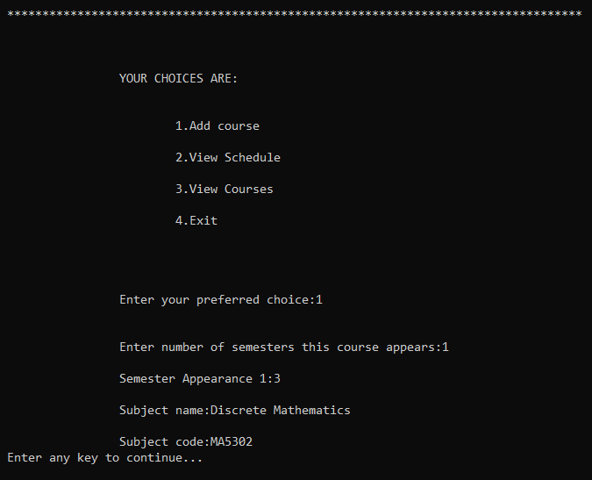

Slide 16
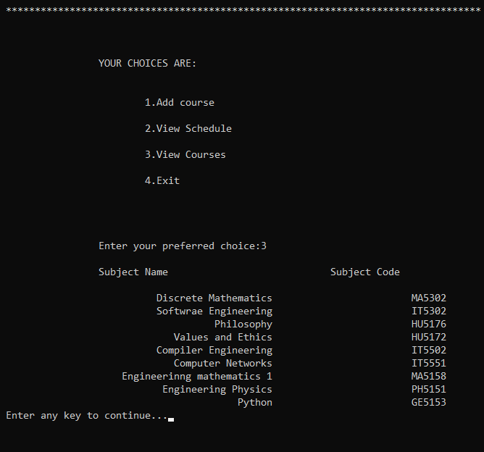

Slide 17
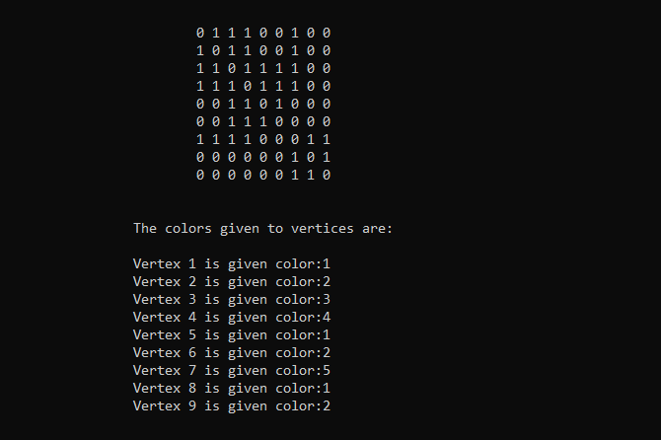

Slide 18
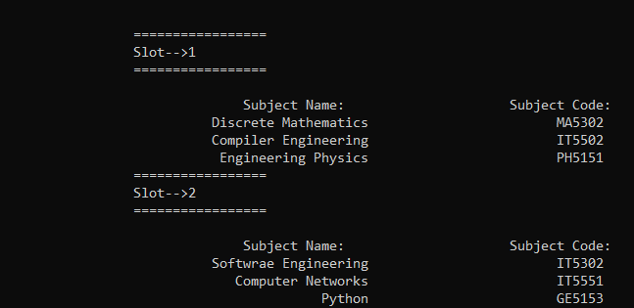

Slide 19
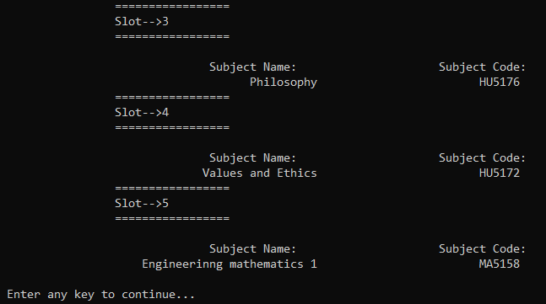

Slide 20
CONCLUSION

Slide 21
In this project we are studied a exam timetable scheduling problem where graph coloring methods were applied and a complete solution provided and it also satisfies important constraints.
Thus by using graph coloring we are able to solve this scheduling problem easily.

Slide 22
THANK YOU

